Slide 1


HackIndia 2024
Project presentation
Team members: Kartik Sharma, Shivam Kumar and Karan Panday

Slide 2


Decentralized Predictive Analytics With AI and Blockchain
Introduction
Our Inspiration
Technologies Implemented
Prototype
Scalability
Summary

Slide 3
Introduction
In today’s fast-paced financial markets, accurate and timely predictions can significantly enhance investment strategies and decision-making processes. Our project, Crypto Trends Prediction Tool, leverages cutting-edge technologies to provide robust and reliable market forecasts. This tool is built using Python Pandas for data manipulation and analysis, Flask for creating a user-friendly web application, and blockchain marketplace technologies to ensure data integrity and security.
Python Pandas is utilized to handle large datasets efficiently, enabling sophisticated data analysis and visualization. The Flask framework powers the web application, offering a seamless and interactive user experience. By integrating blockchain technology, we ensure that all transactions and data exchanges are transparent, immutable, and secure, fostering trust among users.
This project aims to empower investors with advanced predictive analytics, helping them make informed decisions and stay ahead in the competitive stock market landscape.

Slide 4
Our Inspiration
Our inspiration for this project stems from the innovative use of prediction indicators by platforms like Tradetron.in. Tradetron is a powerful algorithmic trading platform that allows users to create, backtest, and deploy trading strategies using a variety of technical indicators. Here are some key ways in which Tradetron utilizes prediction indicators:
1. Technical indicators 2. Algorithmic Strategies 3. Backtesting and optimization 4. Automation and Execution
5. Integration and marketplace
By drawing inspiration from Tradetron’s approach, our project aims to leverage similar prediction indicators and algorithmic strategies to provide accurate and reliable stock market predictions. This will empower investors to make data-driven decisions and enhance their trading performance.

Slide 5
Technologies Implemented
Our Stock Market Prediction Tool leverages a combination of advanced technologies to deliver accurate and reliable predictions. Here’s a brief overview of the key technologies used in this project:
Python Pandas:
Data Manipulation and Analysis: Pandas is a powerful library for data manipulation and analysis. It provides data structures like DataFrames, which are essential for handling large datasets efficiently.
Data Cleaning and Preparation: Pandas offers a wide range of functions for cleaning and preparing data, ensuring that the input data is accurate and ready for analysis.
Statistical Analysis: With Pandas, we can perform various statistical analyses to identify trends and patterns in the stock market data.
Flask:
Web Framework: Flask is a lightweight web framework for Python that allows us to build web applications quickly and easily.
. API Development: Flask is used to develop RESTful APIs that enable communication between the front-end and back-end of our application.

Slide 6
Technologies Implemented
User Interface: Flask helps in creating a user-friendly interface where users can interact with the prediction tool, input data, and view results.
Blockchain Marketplace Technologies:
Data Integrity and Security: Blockchain technology ensures that all transactions and data exchanges are secure, transparent, and immutable. This builds trust among users and protects against data tampering.
Decentralization: By leveraging blockchain, we can create a decentralized marketplace where users can share and access data and algorithms without relying on a central authority.
Smart Contracts: Smart contracts automate the execution of agreements, ensuring that all conditions are met before a transaction is completed. This adds an extra layer of security and efficiency to our platform.
These technologies work together to create a robust and reliable stock market prediction tool, empowering investors with the insights they need to make informed decisions.

Slide 7
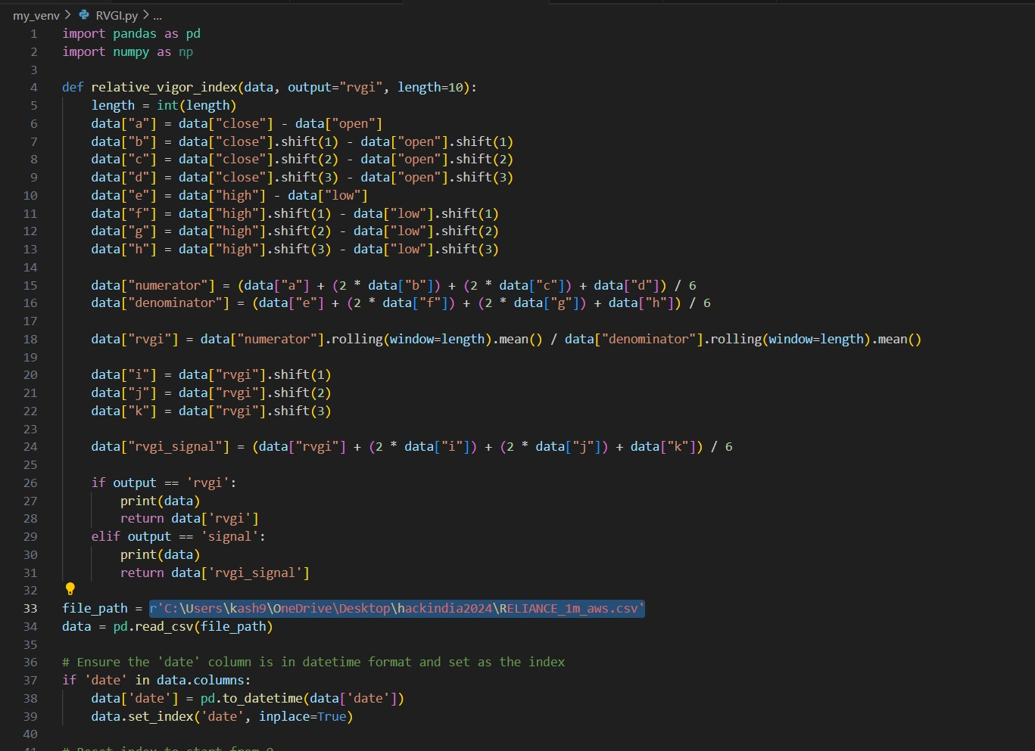
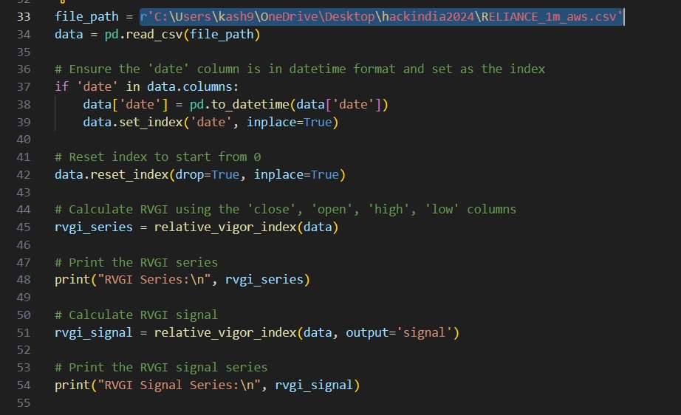
Prototype
In our Stock Market Prediction Tool, we have implemented the Trends like Moving average, daily return, exponential moving average etc- along with the conceptnif Web3 indicator and others to enhance the accuracy of our predictions. The moving averageis a momentum oscillator that measures the strength and direction of a trend by comparing the closing price to the trading range. Our self-implemented moving averageindicator calculates the difference between the closing price and the opening price, normalized by the range of the high and low prices over a specified period.

Slide 8
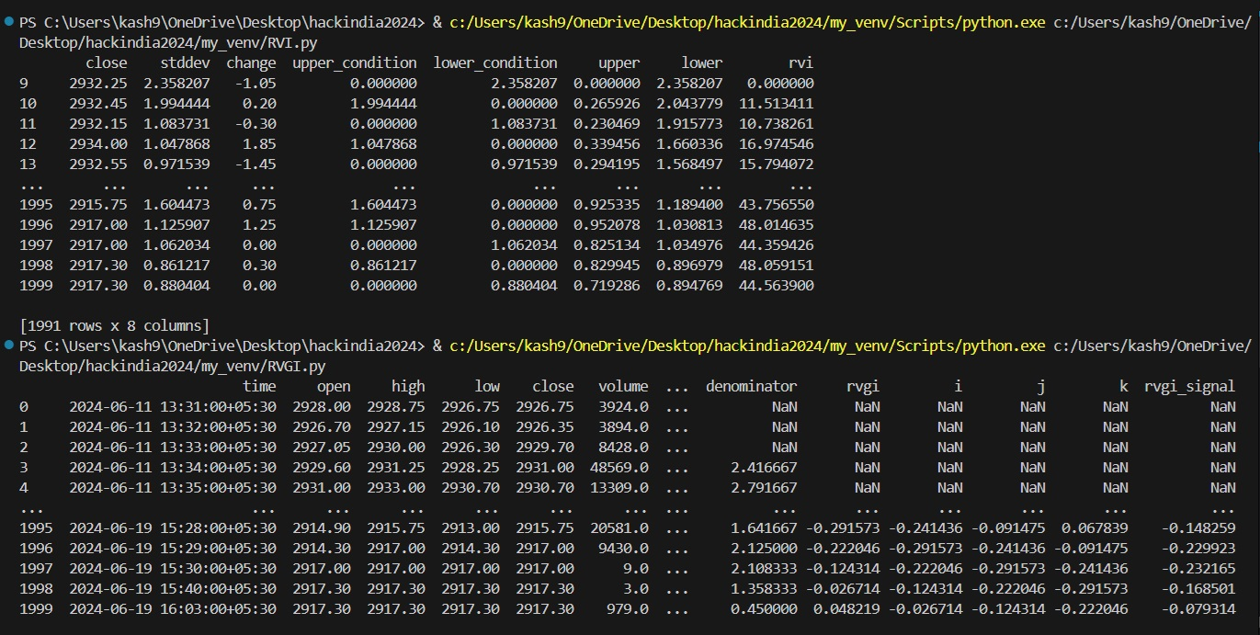
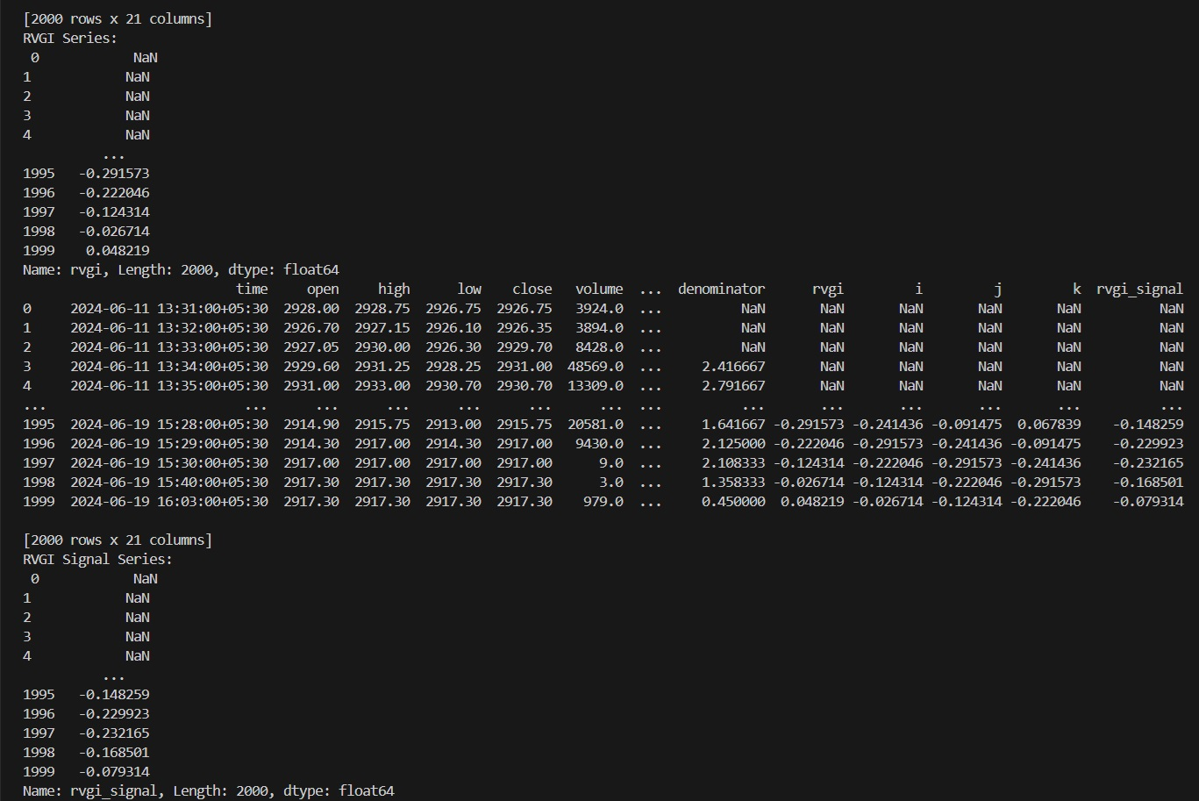
Prototype
This helps in identifying overbought and oversold conditions, providing valuable insights into potential trend reversals. By incorporating the RVGI into our prediction model, we can offer more precise and timely signals, enabling investors to make better-informed decisions in the stock market.

Slide 9
Scalability
Scalability is a crucial aspect of our Stock Market Prediction Tool, ensuring that it can handle increasing amounts of data and users without compromising performance. Here are some key points highlighting the scalability of our project:
Modular Architecture:
Our project is designed with a modular architecture, allowing individual components to be scaled independently. This means that as the user base grows, we can scale specific parts of the system, such as the data processing or web server, without affecting the entire application.
Cloud Integration:
By leveraging cloud services, we can dynamically allocate resources based on demand. This ensures that our application can handle spikes in traffic and large volumes of data efficiently. Cloud platforms like AWS, Azure, or Google Cloud provide scalable infrastructure that can grow with our needs.
Load Balancing:
Implementing load balancers helps distribute incoming traffic across multiple servers, preventing any single server from becoming a bottleneck. This improves the overall performance and reliability of the application, ensuring a smooth user experience even during peak times.

Slide 10
Scalability
Database Optimization:
Using scalable database solutions, such as NoSQL databases or distributed SQL databases, allows us to manage large datasets effectively. These databases can handle high read and write operations, ensuring quick access to data and seamless performance as the dataset grows.
Microservices Architecture:
Adopting a microservices architecture enables us to break down the application into smaller, independent services. Each service can be developed, deployed, and scaled separately, making it easier to manage and scale the application as a whole.
Efficient Data Handling:
With Python Pandas, we can efficiently handle and process large datasets. Additionally, using data streaming technologies can help manage real-time data, ensuring that our predictions are based on the most current information available.
By incorporating these scalability features, our Stock Market Prediction Tool is well-equipped to grow and adapt to increasing demands, providing reliable and efficient service to a larger user base.

Slide 11
Summary
Our Crypto Trends Prediction Tool is an innovative project designed to provide accurate and reliable market forecasts using a combination of advanced technologies. Built with Python Pandas and W3 technilogy for data manipulation and analysis, Flask for creating a user-friendly web application, and blockchain marketplace technologies for ensuring data integrity and security, this tool empowers investors with sophisticated predictive analytics.
Inspired by platforms like Tradingview.com, our tool leverages various prediction indicators, including our self-implemented indicators like moving average, daily return, etc-, to identify market trends and potential reversals. The modular architecture, cloud integration, load balancing, and microservices design ensure the scalability of the project, allowing it to handle increasing amounts of data and users efficiently.
By providing a robust and reliable crypto market prediction tool, we aim to help traders make informed decisions and stay ahead in the competitive financial markets.

